Slide 1

NIRF & AICTE INITIATIVES

Slide 3

Industry Observations
Lack fundamental knowledge of terminology, concepts, principles etc. in their own disciplines
Lack knowledge of current developments in their disciplines and technology
Lack practical skills
Unable to read engineering drawings
Lack analytical ability, willingness to learn, managerial skills and creativity contd….

Slide 4
Contd… Industry Observations
Lack positive attitude and have become more materialistic
Prefer to look for white collar jobs and Prefer to work in IT or ITeS sector and do not continue in the core engineering branches
Commitment
Stability

Slide 5
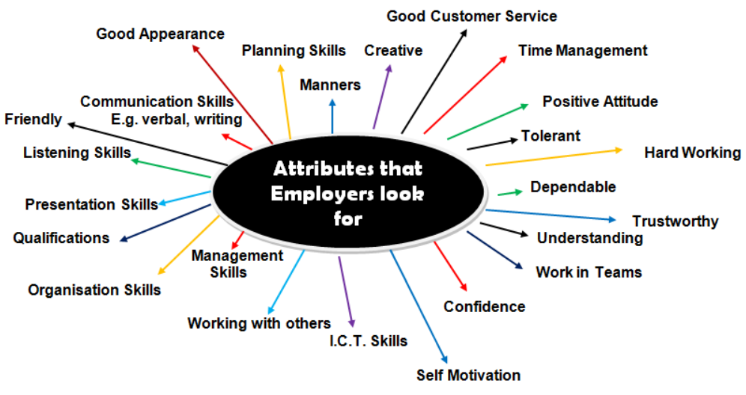
Industry Requirments
Entrepreneurial

Slide 6
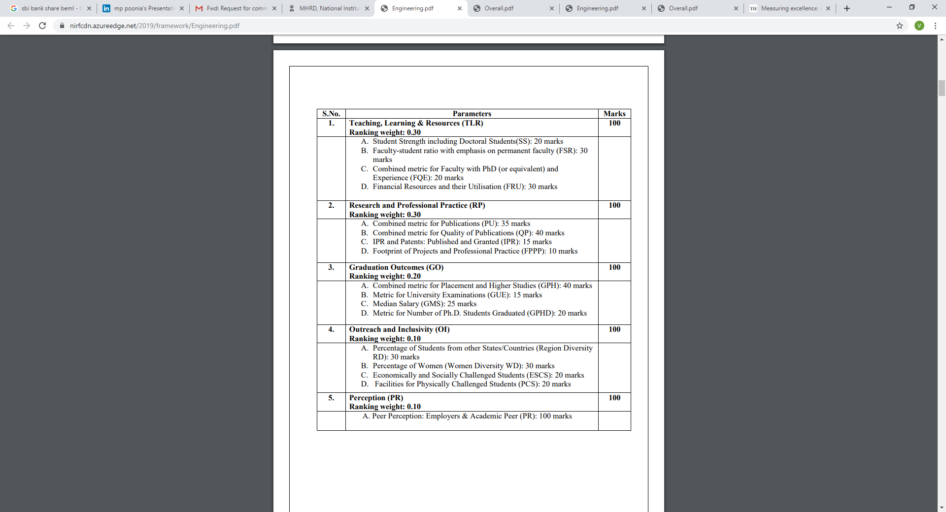

Slide 7

AICTE Quality Initiatives in Technical Education
Revision of Curriculum
Teacher Training
Mandatory Induction program for students
Promoting Innovation/start-ups
Internship Policy
Exam Reforms
Mandatory accreditation
Perspective Plan
Industry Readiness- Mandatory Cell

Slide 8
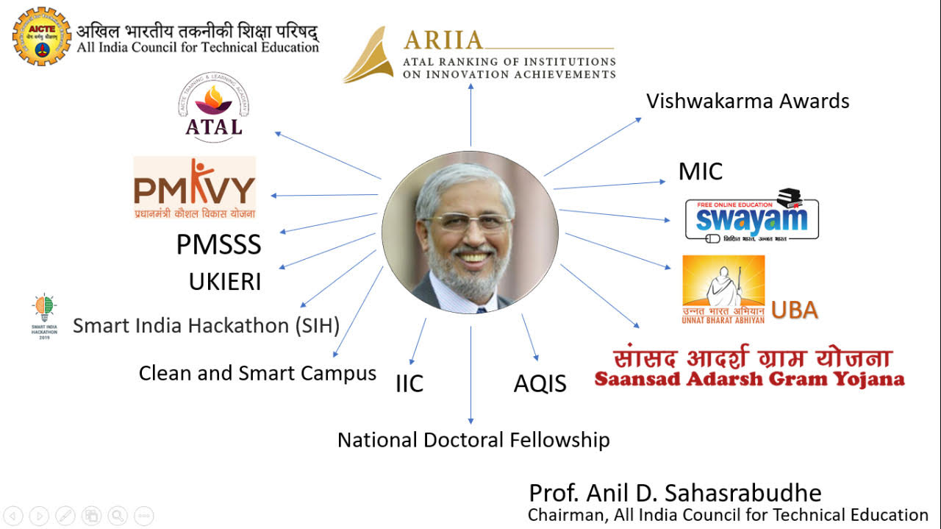

Slide 9
Training Modules During Induction of Teachers
General Orientation towards Technical Education
Inculcation of Values and Attitudes
Communication Skills
Instructional Planning & Classroom Delivery
Technology Enabled Learning and Life-long Self-learning
Effective Modes of Student Evaluation
Creative Problem Solving, Innovation and Meaningful R & D
Institutional Management & Administrative Procedures
2. Summer Internship
3. Mentored Teaching

Slide 10

Institutional Development Schemes
Research Promotion Scheme
Entrepreneur Development Cell
e-Shodh Sindhu
Faculty Development Programme
Quality Improvement Programme
Adjunct Faculty
Seminar Grant
AICTE Travel Grant
Modernization and Removal of Obsolescence

Slide 11
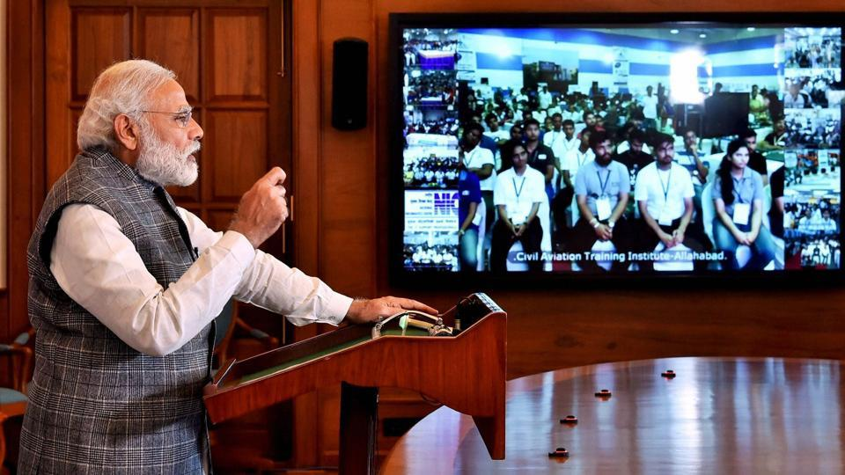
Smart India Hackathon 2016-17
A unique initiative to identify new and disruptive digital solutions for solving the challenges faced by our country under the program of Smart India Hackathon 2017.This 36 Hrs non-stop competition event held on 1st – 2nd April 2017
Smart India Hackathon 2017-18
50 Ministries/ Govt. Departments and 20 states have already committed participation.

Slide 12

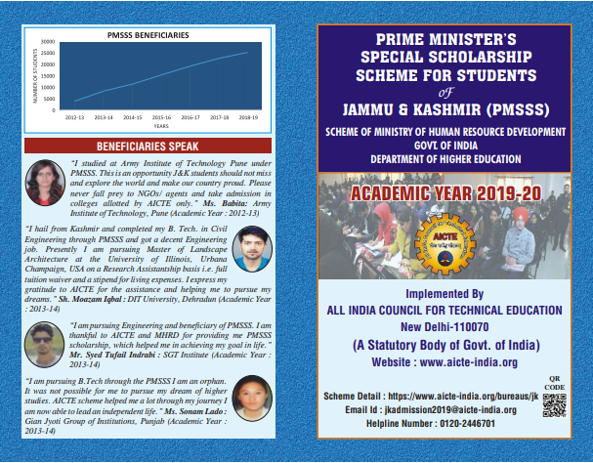
Inclusiveness

Slide 13

Student Development Schemes
PG Scholarship
Pragati Scholarship
Saksham Scholarship Scheme

Slide 14

STRENGTHEN YOUR OWN HOUSE

Slide 15
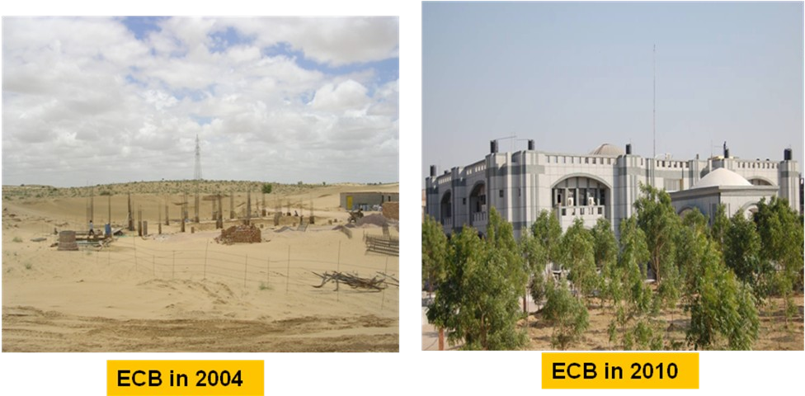
Engineering College Bikaner

Slide 16
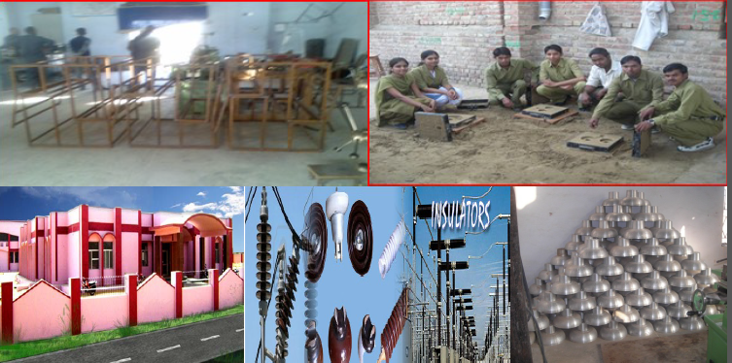

Slide 17
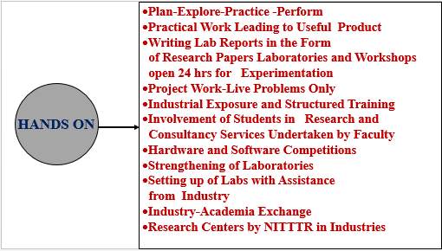
skills
Pankaj_Jindal_Report.docx

Slide 18
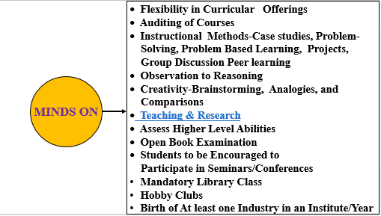
KNOWLEDGE

Slide 19

ATTITUDE
Attitude
Community Surveys by Students
Community Related Projects
Collaboration with NGOs Social Activists for Problem Solving
Interdisciplinary Teams of Students to Work on Social Problems

Slide 20
1st Year
Plan : Familiarising and tinkering with things available at home
2nd Year
Exploration: Familiarising and tinkering with tools and machines at the College Labs and Workshops
Pedagogical Intervention for Capacity Building and Capability Development of the students
3rd Year
Practice: Connect and learn from people of the unorganised sector (e.g. mechanic, artisan, society, small scale industry etc..
4th Year
Perform: Solve problems of the society by using the capability developed

Slide 21
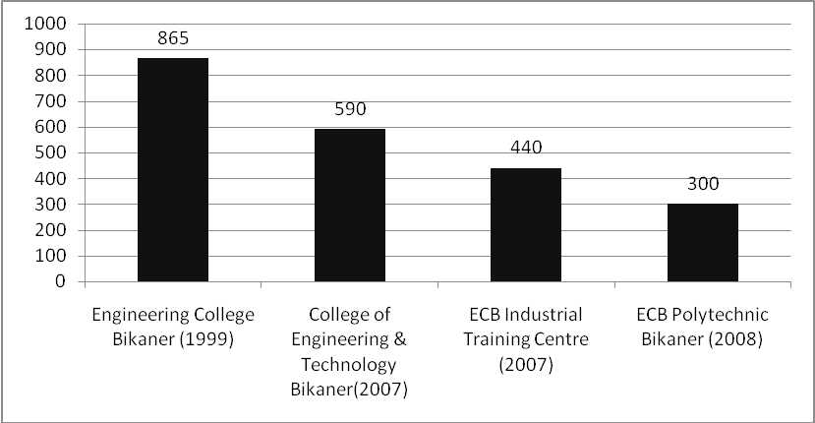
Engineering College Bikaner Society

Slide 22
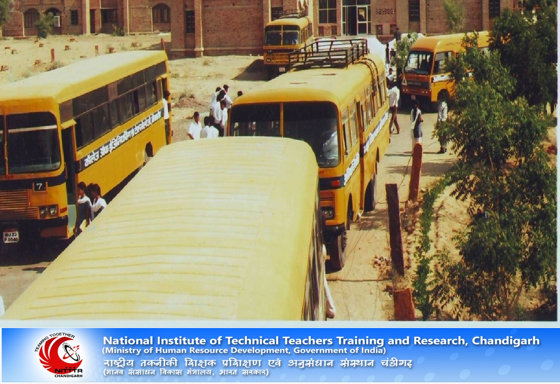
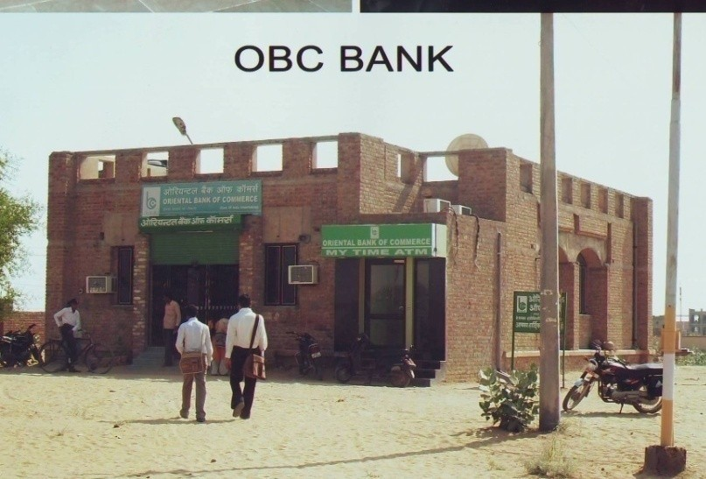
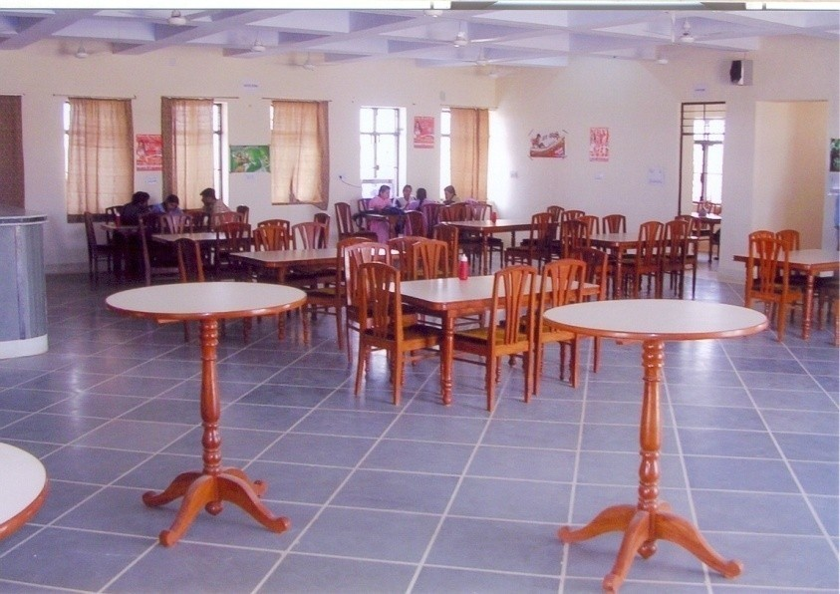
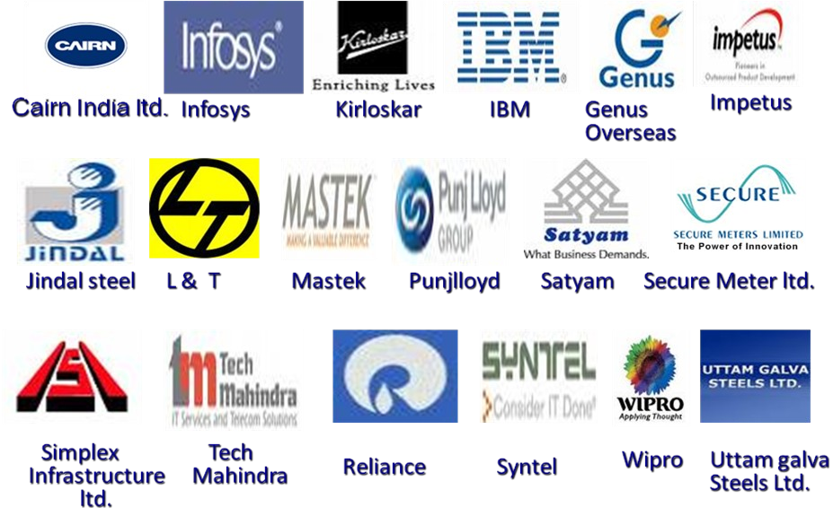

Slide 23
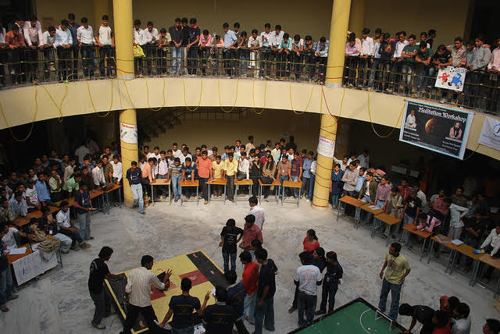
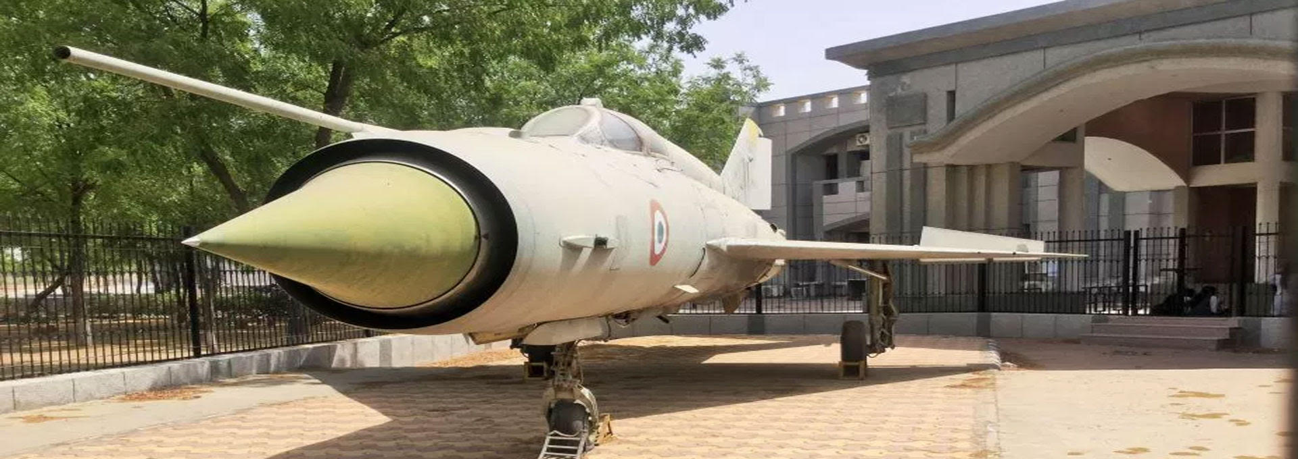
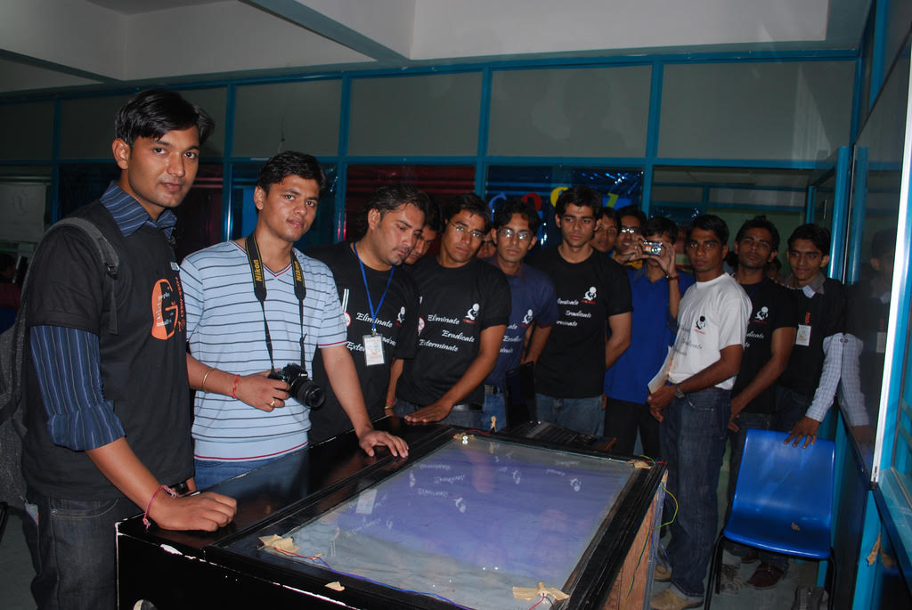

Slide 24

A tree is known by its fruits
Fundamentals
Create Interest
Transformation
Employability Skills
Life Long Learner
Value based, sensitive human beings

Slide 25
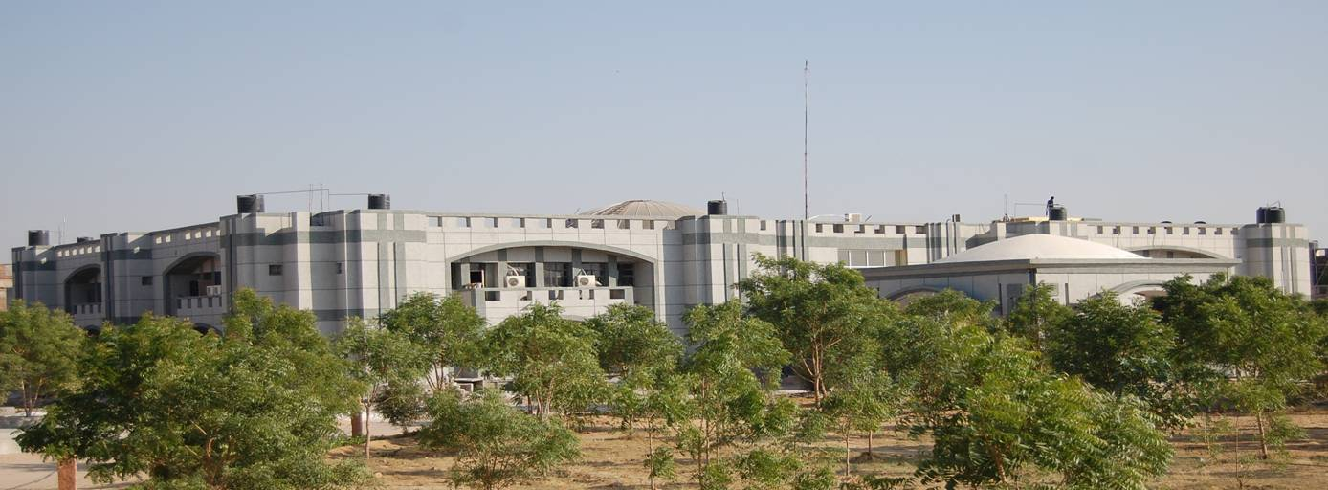
ECB IN 2010

Slide 26



MARGDARSHAK & MARGDARSHAN
Mandatory for all technical institutions to have their 100% programs NBA/ NIRF accredited in next Five years, else no extension of approval will be granted.
Approx. 300 Margdarshaks identified and trained to mentor atleast 4 institutions/mentor.
Thirty Nine Institutions Selected under Scheme Margdarshan.
26

Slide 27
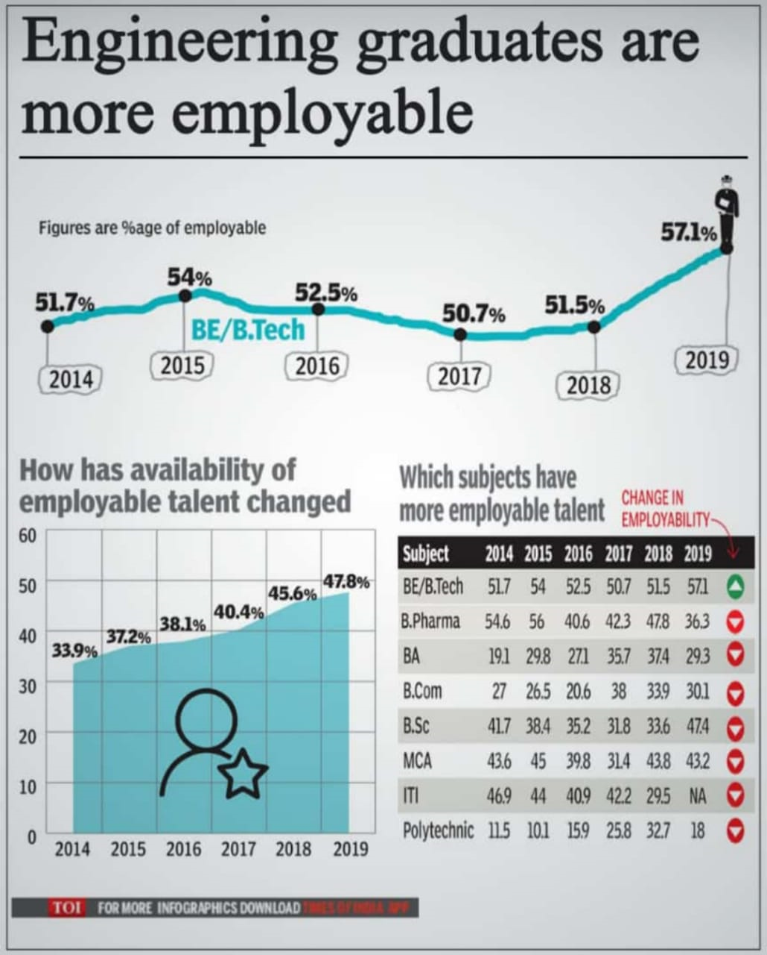
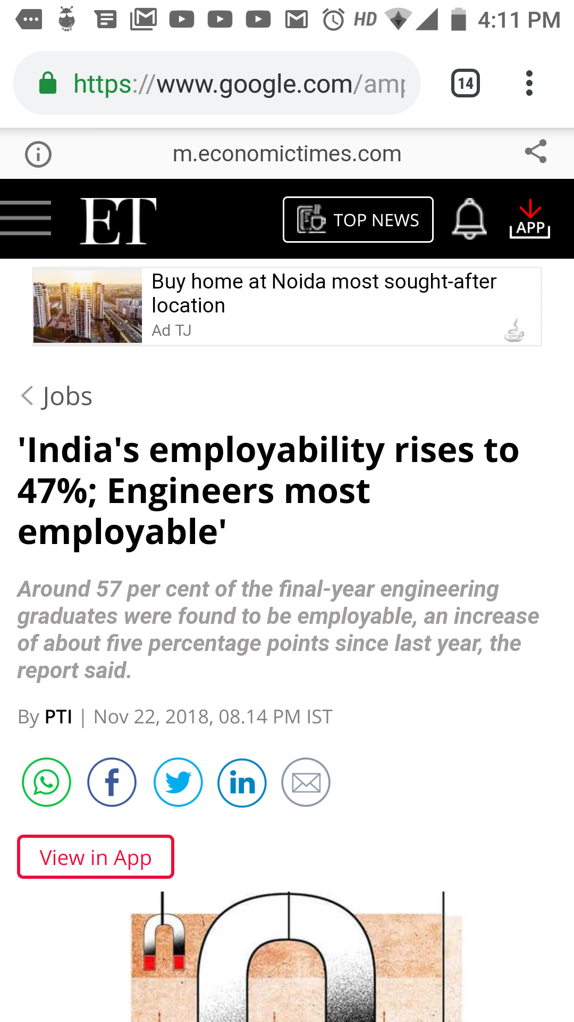
News
'India's employability rises to 47%; Engineers most employable' : Around 57 per cent of the final-year engineering graduates were found to be employable, an increase of about five percentage points since last year, the report said.
Courtesy :- https://www.google.com/amp/s/m.economictimes.com/jobs/indias-employability-rises-to-47-engineers-most-employable/amp_articleshow/66754055.cms

Slide 28


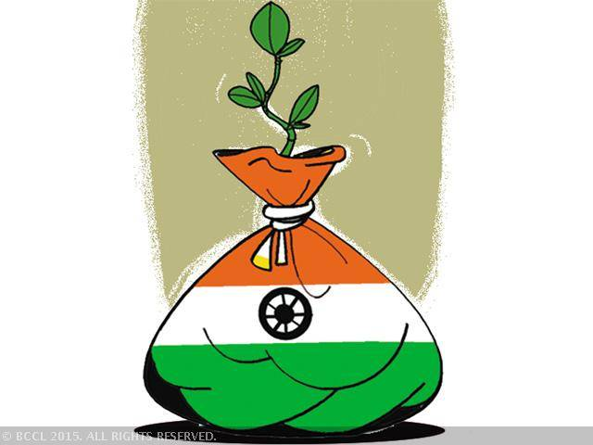

Thank You
vcm@aicte-india.org
https://www.facebook.com/drmppoonia

